Slide 1
A single global public-utility blockchain & cryptosystem
What is Bitcoin?

Slide 2
Outline
Usability & Accessibility
Data carrier transactions
  Cheap transactions
    Bitchat & BitcoinAPI
    on-chain graffiti
  Increased nulldata tx OP_RETURN size
    SPAM, data: URIs & media viewers
    sound money
    Vlogs & Bcats (mass storage of large files)
    EDI
Identity & Authenticity
  Integrate Bitcoin with the Internet’s fundamental protocols
  Email, DNS & the Web form to create Paymail
  Secure on-chain archival storage

Slide 3
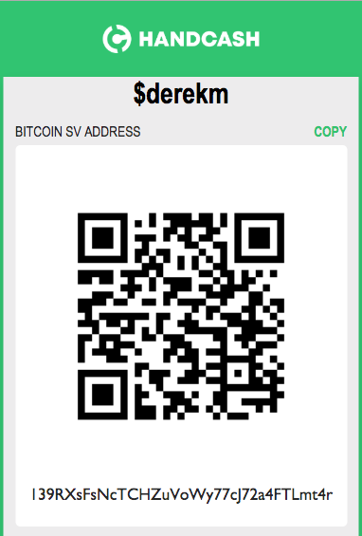
Payments are hard!
handcash.to/$derekm

Slide 4
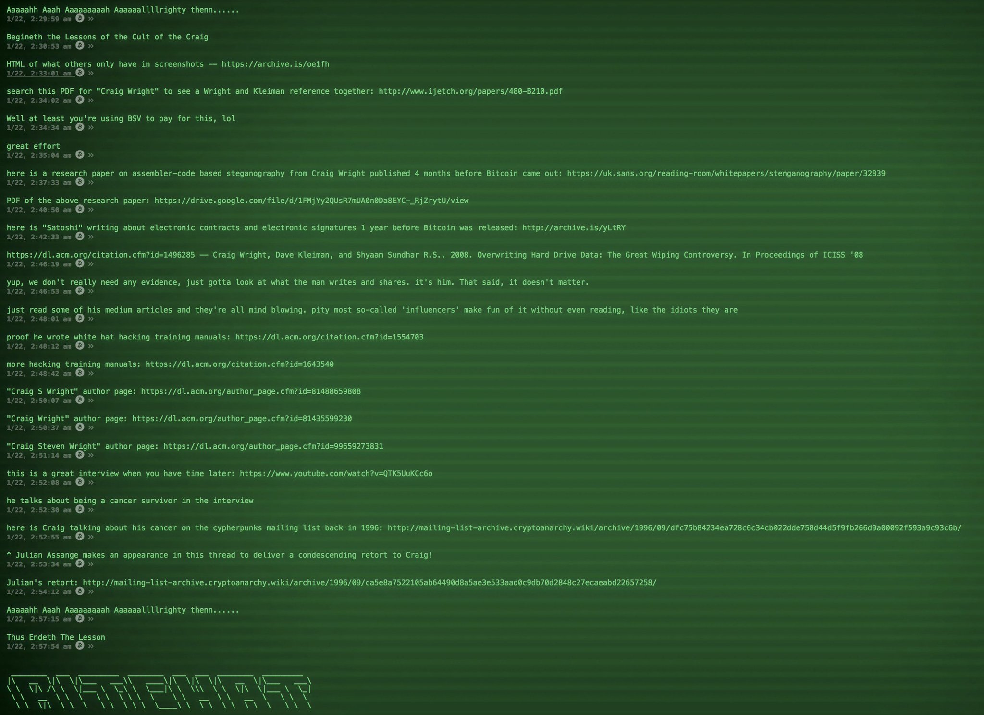
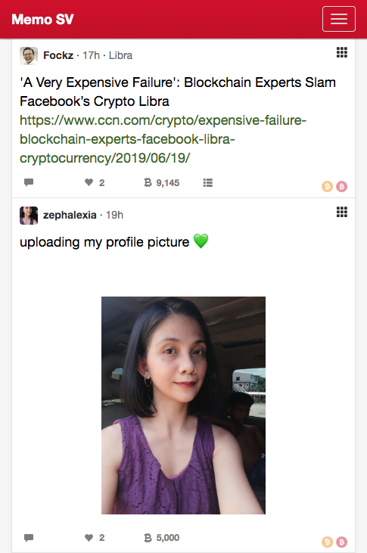
The Early Days
of
Data Carrier Txs
was 220 bytes
Protocol prefixes
Memo 0x6d02
Bitchat 0x6a00

Slide 5
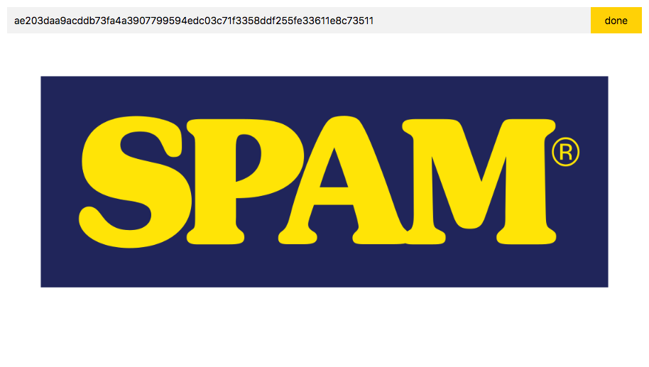
The Modern Era
of
Data Carrier Txs
now 100,000 bytes
alice.bitdb.network
On-chain Graffiti
Plaintext
https://bico.media/7535bea47ce3e5770406e8302ce13c474090add71a8d3cf712c42d71dbf935d1
SPAM data: URIs
viewer.bitdb.network/#ae203daa9acddb73fa4a3907799594edc03c71f3358ddf255fe33611e8c73511
SOUND MONEY
https://api.svblox.com/v1/file/3b64bc16a45be0ab55b9ce4c8738ed269f4e773d1a7ee8f69932e9a3bb7ac022/0/SORRYDAV.mp3
https://api.svblox.com/v1/file/625f9256093e011db4a8467535edc425390102932660f9e8496531c4bbb21769/0/ENJOY.mp3
https://api.svblox.com/v1/file/d9c866afe3a285b9a8064b7bff1ad95bcb8ae4bf5f364260cbc496af43aea556/0/INTHPOD.mp3

Slide 6
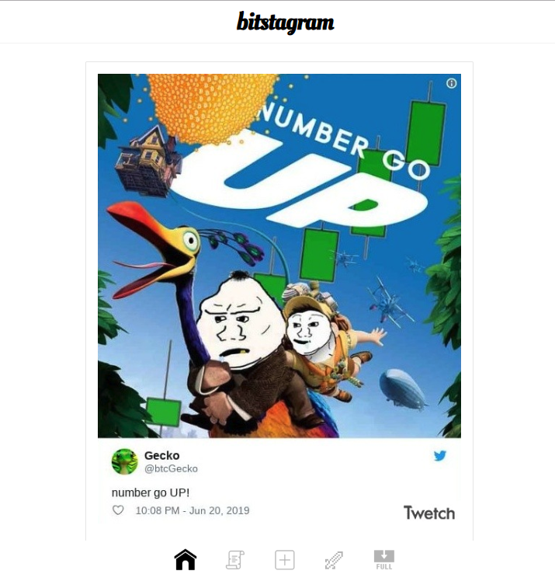
Bitcom Protocols
bitcom.bitdb.network
Bitcoin Simple Storage (aka "B")
19HxigV4QyBv3tHpQVcUEQyq1pzZVdoAut
  Spec:
  b.bitdb.network
  Example:
  bitstagram.bitdb.network
B:// URIs
b://[txid]
b://40c8833166372942e328672a86b977e131f86c1f069ed0ea3515677e8f956288

Slide 7
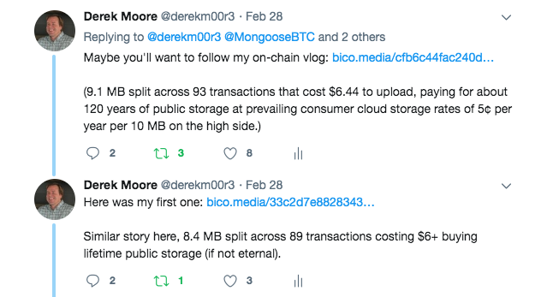
Bitcom Protocols
Bitcoin Concatenated Storage (aka "Bcat")
Master transaction
15DHFxWZJT58f9nhyGnsRBqrgwK4W6h4Up
File part transactions
1ChDHzdd1H4wSjgGMHyndZm6qxEDGjqpJL
  Spec:
  bcat.bico.media
Derek's On-chain Vlog, Ep. 2
https://bico.media/cfb6c44fac240db9db03a0174b651efce26b13b40ae9138dc0320e7ed59e27f7

Slide 8
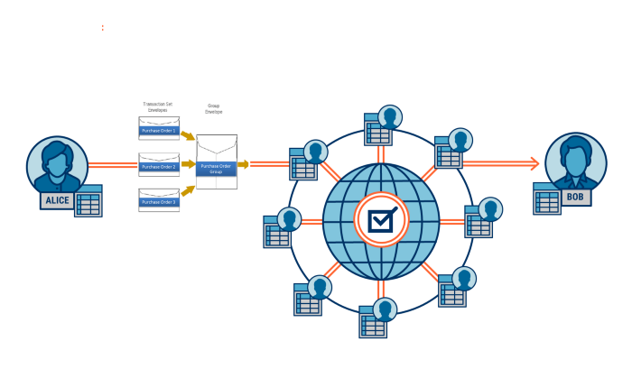
Electonic
Data Interchange
ASC X12 business-to-business transactions
GS1 int'l supply chain transactions
HIPAA, HL7 & FHIR health record transactions
Bitcoin, the ultimate Value-Added Network (VAN), can connect PeopleSoft, SAP, Dynamics, and more via a common interface and data interaction layer

Slide 9
EDI ➡ BDI
Electronic Data Interchange
becomes
Bitcoin Data Interchange

Slide 10
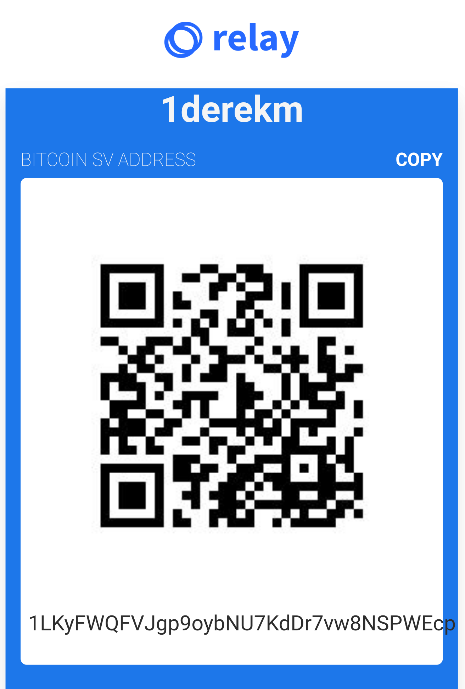
Payments get easier!
paycash.to/1derekm

Slide 11
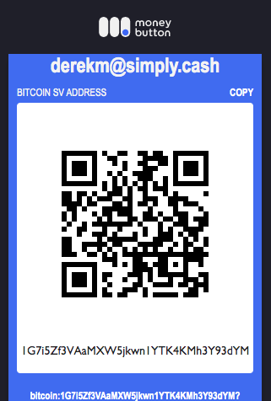
Paymail introduced!
paycash.to/derekm@simply.cash

Slide 12
Paymail
Send to derekm@simply.cash
$ dig srv _bsvalias._tcp.simply.cash
_bsvalias._tcp.simply.cash. 599 IN SRV 10 10 443 simply.cash.
GET https://simply.cash:443/.well-known/bsvalias
{
"bsvalias": "1.0",
"capabilities": {
"6745385c3fc0": false,
"pki": "https://simply.cash/api/bsvalias/id/{alias}@{domain.tld}",
"paymentDestination": "https://simply.cash/api/bsvalias/address/{alias}@{domain.tld}",
"a9f510c16bde": "https://simply.cash/api/bsvalias/verifypubkey/{alias}@{domain.tld}/{pubkey}"
}
}
POST https://simply.cash/api/bsvalias/address/derekm@simply.cash
{
"senderName": "FirstName LastName",
"senderHandle": "<alias>@<domain.tld>",
"dt": "<ISO-8601 timestamp>",
"amount": 550,
"purpose": "message to receiver",
"signature": "<compact Bitcoin message signature>"
}
Response
{
"output": "76a9140806efc8bedc8afb37bf484f352e6f79bff1458c88ac"
}
HOWTO

